Slide 1
NYC Parking group case study using apache spark
Group Members:
Vijayanand Narayanan
Arunachalam Meenakshisundaram
Akash Ashokan
Dharamarajan Thiyagarajan

Slide 2
Business Problem
New York City is a thriving metropolis. Just like most other metros that size, one of the biggest problems its citizens face, is parking. The classic combination of a huge number of cars, and a cramped geography is the exact recipe that leads to a huge number of parking tickets.
NYC Police Department has collected data for parking tickets consisting of big data from 2015 to 2017

Slide 3
Objectives
Understand the dataset provided by NYPD and
Conduct exploratory analysis of data for each of the years 2015, 2016 and 2017
Use Apache Spark to access the dataset, examine the data and perform aggregation tasks to discover useful patterns and insights

Slide 4
Problem Solving Methodology
Understand the business problem
Use dataset that has been provided
Load dataset into HDFS and use Apache Spark to carry out analysis
Clean data and address all data quality issues
Univariate analysis of Parking Tickets
Multivariate analysis of other variables impacting Parking Tickets
Perform Exploratory Data Analysis by creating buckets based on various times of day
Perform seasonality analysis by bucketing tickets into various seasons of the year

Slide 5
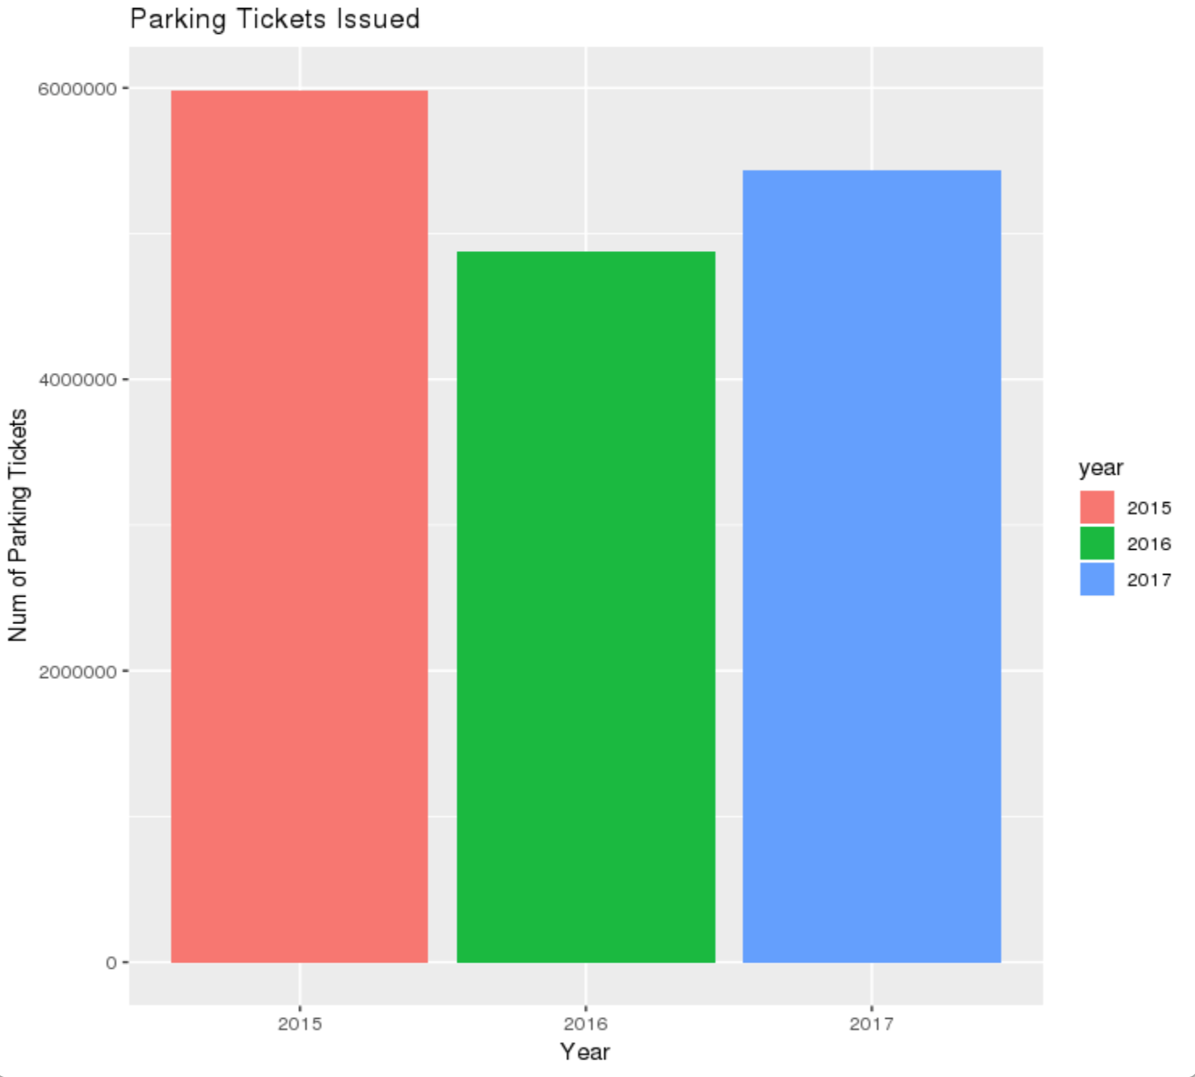
Univariate Analysis
Parking tickets for all 3 years were above 4 million
There was drop in the number of tickets issued in 2016 but increased again in 2017

Slide 6
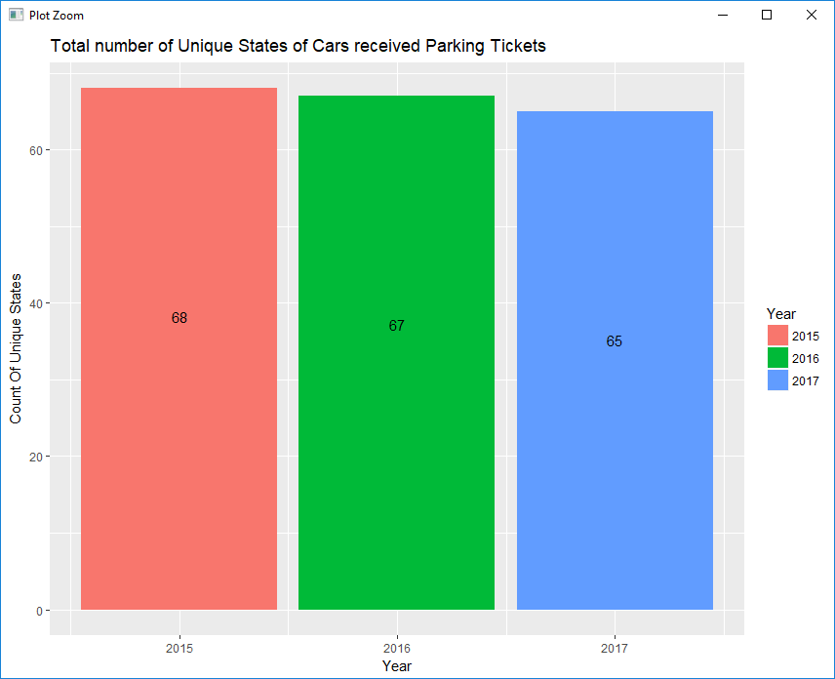
Cars From States that Received Tickets
Cars from various states in USA and Canada received tickets
Count of number of states is similar in all 3 years
Year | Count of unique states
2015 | 68
2016 | 67
2017 | 65

Slide 7
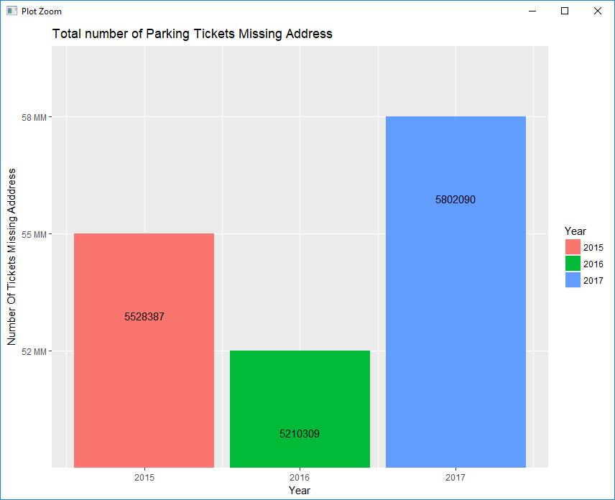
Parking Tickets with Address Issues
All the 3 years have over 5.2 million tickets that either did not have place where violation occurred or have house number or street name
Year | Number of tickets Missing Address
2015 | 5528387
2016 | 5210309
2017 | 5802090

Slide 8
Top Five Violation Codes
Year | Violation Code | Count
2015 | 21 | 720902
2015 | 38 | 663904
2015 | 14 | 466488
2015 | 36 | 406249
2015 | 37 | 373229
Year | Violation Code | Count
2016 | 21 | 664946
2016 | 36 | 615242
2016 | 38 | 547080
2016 | 14 | 405883
2016 | 37 | 330489
Year | Violation Code | Count
2017 | 21 | 768087
2017 | 36 | 662765
2017 | 38 | 542079
2017 | 14 | 476664
2017 | 20 | 319646
Top most commonly occurring violation code in all 3 years was 21
Violation codes 36, 38 and 14 occurred in all 3 years

Slide 9
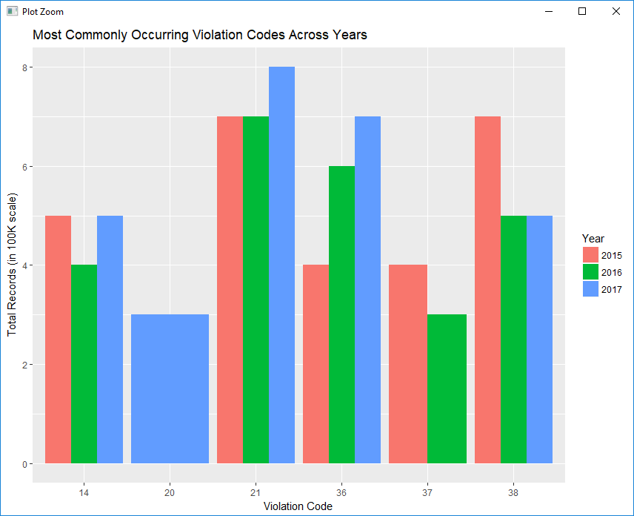
Top Violation Codes
Top most commonly occurring violation code in all 3 years was 21
Violation codes 36, 38 and 14 occurred in all 3 years

Slide 10
Top Five Vehicle Body Types
Year | Vehicle Body | Count
2015 | SUBN | 1715517
2015 | 4DSD | 1514580
2015 | VAN | 795457
2015 | DELV | 419548
2015 | SDN | 209381
Year | Vehicle Body | Count
2016 | SUBN | 1596325
2016 | 4DSD | 133994
2016 | VAN | 722234
2016 | DELV | 354388
2016 | SDN | 178954
Year | Vehicle Body | Count
2017 | SUBN | 1883954
2017 | 4DSD | 1547312
2017 | VAN | 724029
2017 | DELV | 358984
2017 | SDN | 194197
5 most commonly occurring vehicle body types that received parking tickets remained consistently similar in all 3 years
Suburban Vehicle Type received the most parking tickets in all 3 years
Suburban, 4 Door Sedan and Vans were the vehicle types that received maximum parking tickets

Slide 11
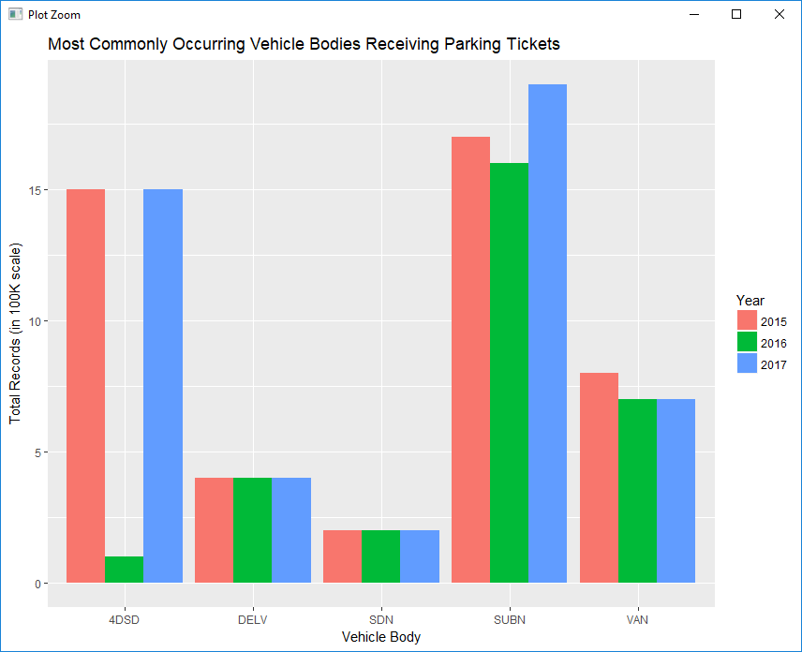
Common Vehicle Body Types
Suburban Vehicle Type received the most parking tickets in all 3 years
Suburban, 4 Door Sedan and Vans were the vehicle types that received maximum parking tickets

Slide 12
Top Five Make of Vehicles
Year | Vehicle Make | Count
2015 | FORD | 685900
2015 | TOYOT | 554392
2015 | HONDA | 498858
2015 | NISSA | 411857
2015 | CHEVR | 404841
Year | Vehicle Make | Count
2016 | FORD | 612276
2016 | TOYOT | 529115
2016 | HONDA | 459465
2016 | NISSA | 382080
2016 | CHEVR | 339466
Year | Vehicle Make | Count
2017 | FORD | 636844
2017 | TOYOT | 605291
2017 | HONDA | 538884
2017 | NISSA | 462017
2017 | CHEVR | 356032
5 most commonly occurring vehicle makes that received parking tickets remained consistently similar in all 3 years
FORD, TOYOTA and HONDA vehicles received the most number of parking tickets

Slide 13
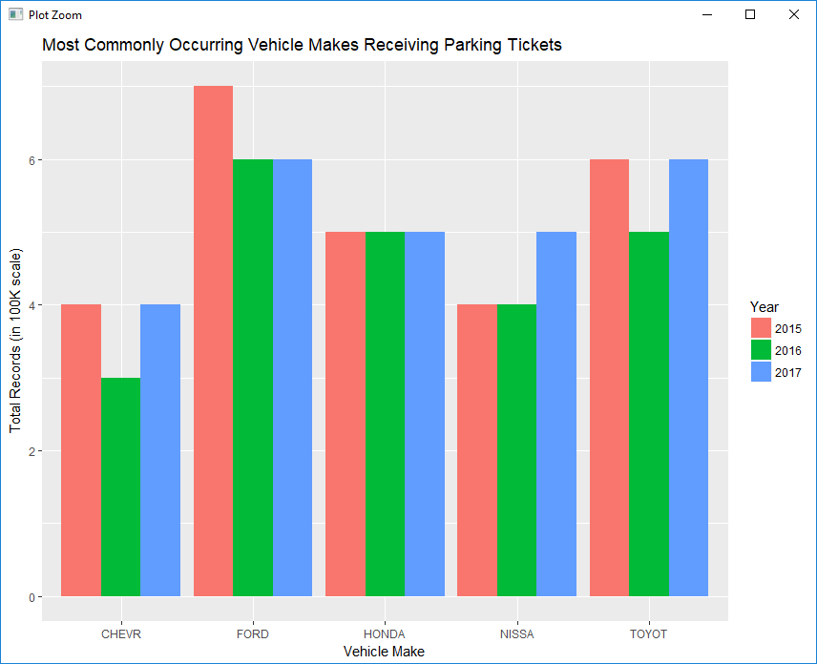
Common Make of Vehicles
FORD, TOYOTA and HONDA vehicles received the most number of parking tickets

Slide 14
Top Five Violation Precincts
Year | Violation Precinct | Count
2015 | 0 | 721275
2015 | 19 | 287403
2015 | 14 | 197011
2015 | 18 | 193593
2015 | 1 | 127483
Year | Violation Precinct | Count
2016 | 0 | 828348
2016 | 19 | 264299
2016 | 13 | 156143
2016 | 1 | 152231
2016 | 14 | 150637
Year | Violation Precinct | Count
2017 | 0 | 925596
2017 | 19 | 274445
2017 | 14 | 203553
2017 | 1 | 174702
2017 | 18 | 169131
Precinct 0 is not a valid zone and does not appear in the NYPD precincts list available on https://www1.nyc.gov/site/nypd/bureaus/patrol/precincts-landing.page
Zone 19 has the next maximum number of parking tickets. The 19th Precinct command serves the Upper East Side of Manhattan.

Slide 15
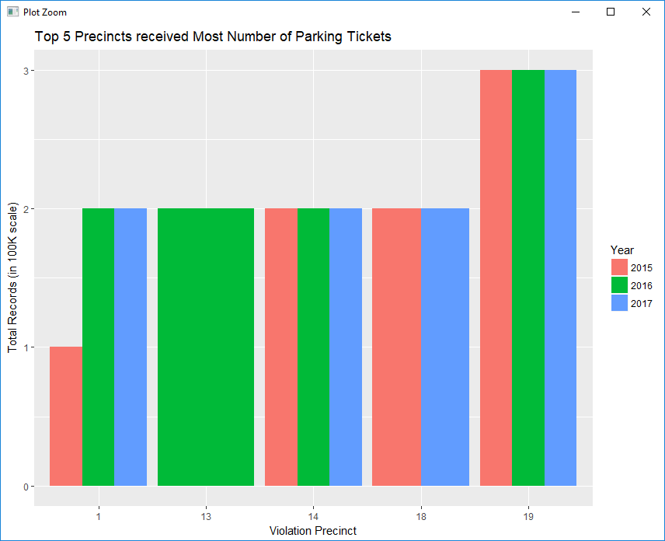
Common Violation Precincts
Zone 19 has the next maximum number of parking tickets. The 19th Precinct command serves the Upper East Side of Manhattan.

Slide 16
Top Five Issuing Precincts
Year | Issuer Precinct | Count
2015 | 0 | 828570
2015 | 19 | 279931
2015 | 14 | 190403
2015 | 18 | 190337
2015 | 114 | 149532
Year | Issuer Precinct | Count
2016 | 0 | 948438
2016 | 19 | 258049
2016 | 13 | 153477
2016 | 1 | 146987
2016 | 14 | 146165
Year | Issuer Precinct | Count
2017 | 0 | 1078406
2017 | 19 | 266961
2017 | 14 | 200495
2017 | 1 | 168740
2017 | 18 | 162994
Ignoring Issuer Precinct 0 as it is is not valid station
Police Stations of Manhattan (Upper East, Midtown North, South and Ericson Palace) and Northwest Queens have issued the most number of tickets in 2015 and 2017
Police stations of Manhattan (Upper East,South) and New York East 21st street and New York Ericcson Place have had the maximum number of parking tickets issued in 2016

Slide 17
Top Violation Code in Top 3 Issuer Precinct
2015 - Top 3 Issuer Precincts - 19,14,18
2016 - Top 3 Issuer Precincts - 19,13,1
2017 – Top 3 Issuer Precincts - 19, 14, 1
Violation code 14 had a very high frequency in all 3 years
Violation Code | Count
14 | 129607
69 | 71598
38 | 58288
Violation Code | Count
14 | 113187
46 | 68869
38 | 48190
Violation Code | Count
14 | 78685
38 | 62192
37 | 57678

Slide 18
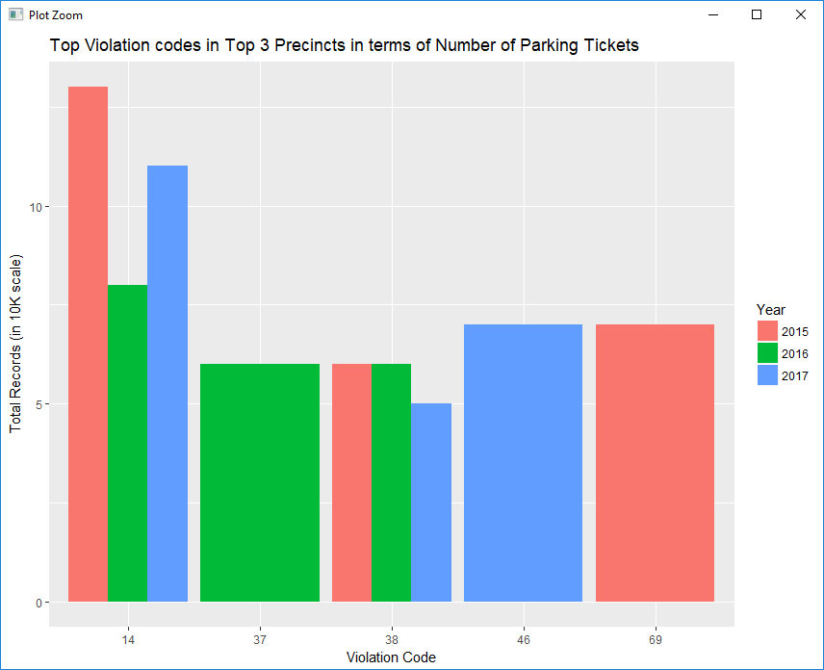
Top Violation Code in Top 3 Issuer Precinct
Violation code 14 had a very high frequency in all 3 years

Slide 19
Violations across times of day
Time | Bin | Comments
00 to 03 AM | Bin 1 | Includes times starting with 12 AM
04 to 07 AM | Bin 2
08 to 11 AM | Bin 3
12 to 15 PM | Bin 4 | Includes 00 to 03 PM
16 to 19 PM | Bin 5 | Includes 04 to 07 PM
20 to 23 PM | Bin 6 | Includes 08 to 11 PM
A standard 24 hour time convention was missing in the data
A few parking tickets were missing Violation Time and were excluded from analysis

Slide 20
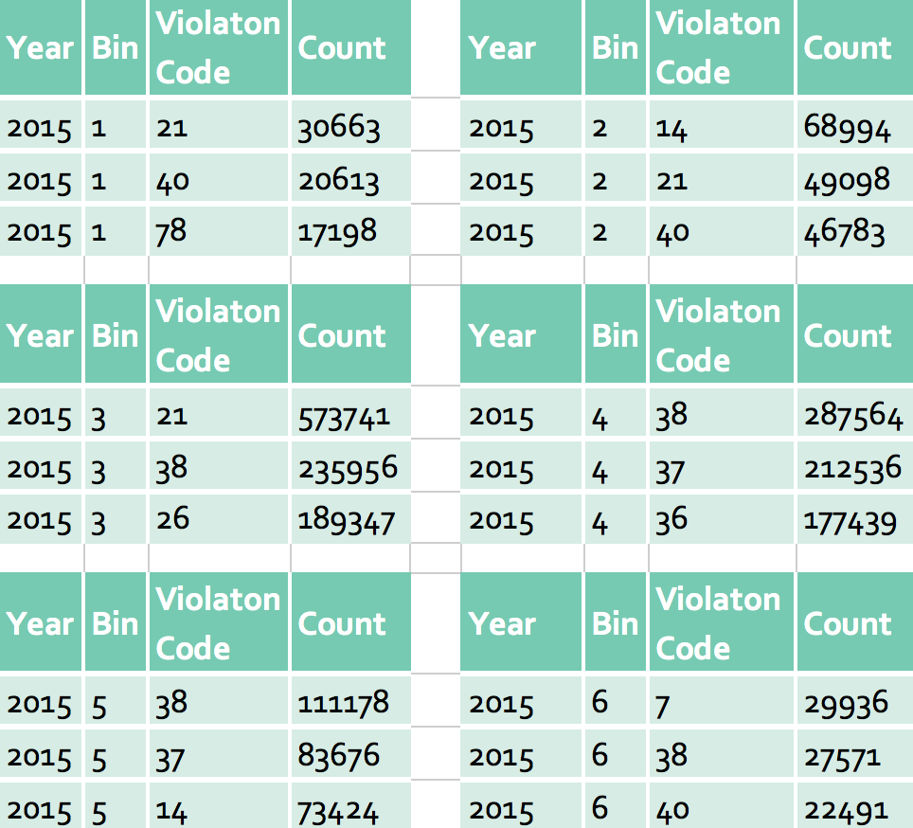
Top 3 violations across times of day
Violations were the highest between 4 and 7 PM
Parking in excess of the allowed time or failing to show a receipt and parking where it is not allowed were the most common reasons for receiving parking ticket during these hours
Going through red light at an intersection is the most common violation after 10 PM
Stopping closer to 15 feet of fire hydrant is also common during late nights and early mornings

Slide 21
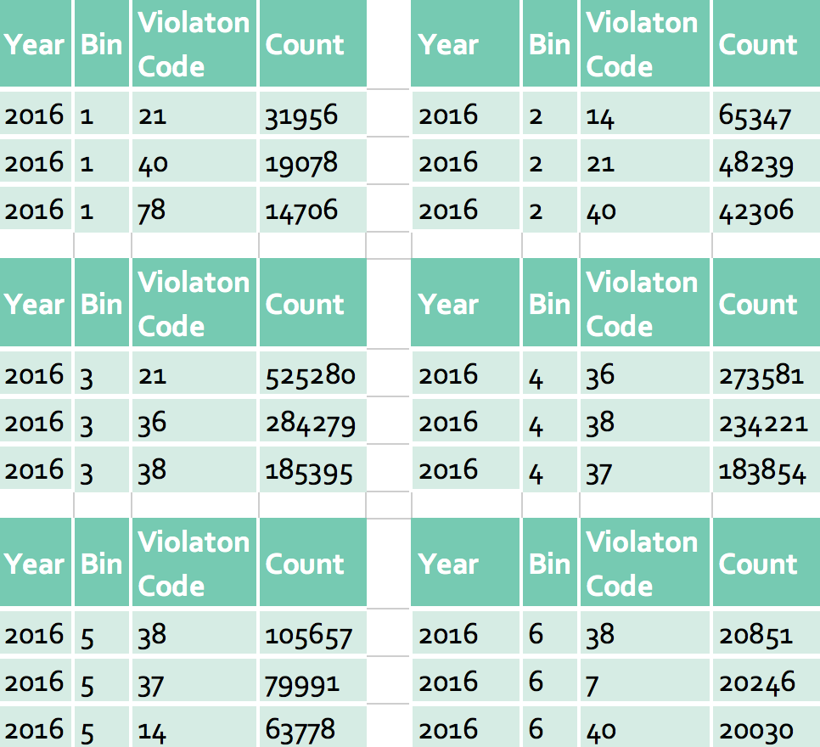
Top 3 violations across times of day
Violations were the highest between 4 and 7 PM
Parking in excess of the allowed time or failing to show a receipt and parking where it is not allowed were the most common reasons for receiving parking ticket during these hours
Violations were high between 8 and 11 AM.
No parking where not allowed, Failing to show a receipt and exceeding allowed time were the most common reasons

Slide 22
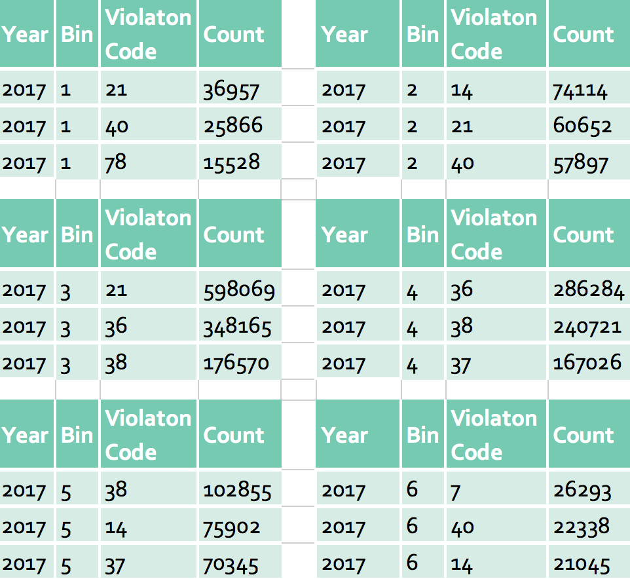
Top 3 violations across times of day
Violations were the highest between 8 and 11 AM
No parking where not allowed, Failing to show a receipt and exceeding allowed time were the most common reasons
Violations were high between 4 and 7 PM.
Parking in excess of the allowed time or failing to show a receipt and parking where it is not allowed were the most common reasons for receiving parking ticket during these hours
Going through red light at an intersection is the most common violation after 10 PM.

Slide 23
Top 3 Commonly Occurring Violations
2015
2016
2017
Top 3 most commonly occurring violations were 21, 38 ad 36
These violations were - No parking where not allowed, Failing to show receipt and Exceeding allowed time
Violation Code | Count
21 | 720890
38 | 663904
376 | 466479
Violation Code | Count
21 | 664914
36 | 615242
38 | 547080
Violation Code | Count
21 | 768065
36 | 662795
38 | 542078

Slide 24
Top 3 Times when Violations Occur
2015
2016
2017
Most violations occur consistently in bins 3 to 5 i.e from 8 AM to 7 PM in all years
It can be seen that “No parking where not allowed, Failing to show receipt and Exceeding allowed time” occur during the day and evenings
Time Bin | Count
Bin 3 | 999044
Bin 4 | 531823
Bin 5 | 119943
Violation Code | Count
Bin 3 | 994954
Bin 4 | 566791
Bin 5 | 124172
Violation Code | Count
Bin 3 | 1122804
Bin 4 | 601701
Bin 5 | 116650

Slide 25
Violations across seasons of the year
Month | Bin
01 to 03 | Bin 1
04 to 06 | Bin 2
07 to 09 | Bin 3
10 to 12 | Bin 4
Divide the year into 4 quarters representing 4 seasons
For simplicity using convention 1 to 3 months for Spring, 4 to 6 as Summer, 7 to 9 as Autumn and 10 to 12 as Winter

Slide 26
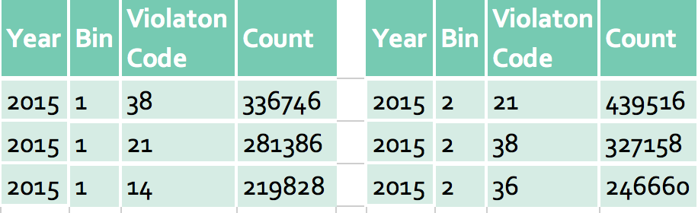
Top 3 violations across seasons
There were no records in Bins 3 and 4
Failing to show parking ticket, exceeding time limit and parking where not allowed were the common reasons for receiving parking tickets in 2015

Slide 27
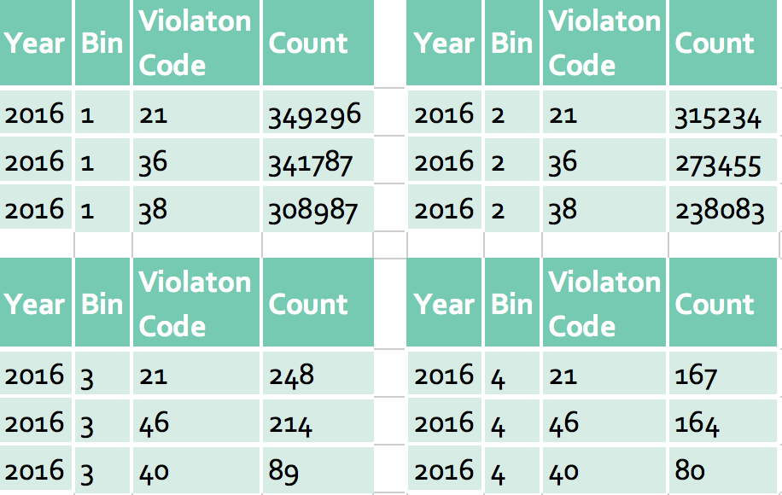
Top 3 violations across seasons
Failing to show parking ticket, exceeding time limit and parking where not allowed were the common reasons for receiving parking tickets all year round
Exceeding the posted speed limit in or near a designated school zone was also high during Jan to June
Stopping, standing or parking closer than 15 feet of a fire hydrant was also high and from June to Dec

Slide 28
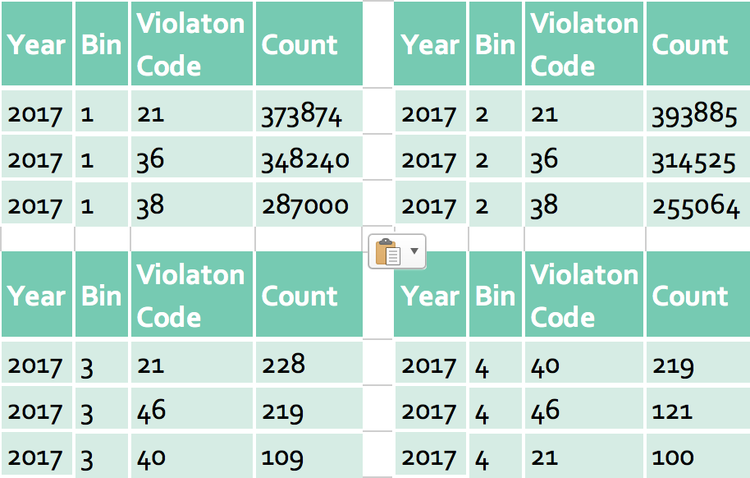
Top 3 violations across seasons
No parking where not allowed was the common reason for receiving parking tickets all year round
Also Failing to show parking ticket, exceeding time limit were common during the year
Stopping, standing or parking closer than 15 feet of a fire hydrant was also high and from June to Dec

Slide 29
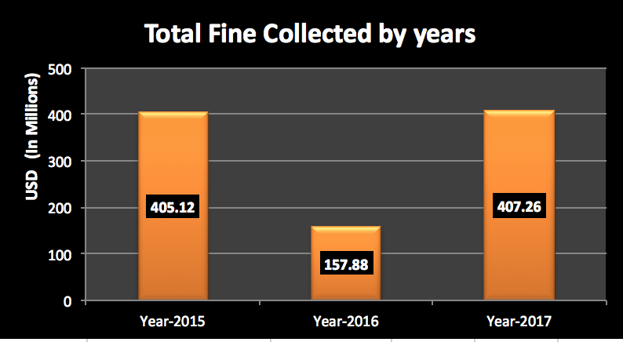
Total Fine Collected
Most fine was collected in 2017
Total fine collected in 2016 was low compared to the other years and seems to have dropped drastically in that year
Year | Total in $
2015 | 405129342
2016 | 157889070
2017 | 407266465

Slide 30
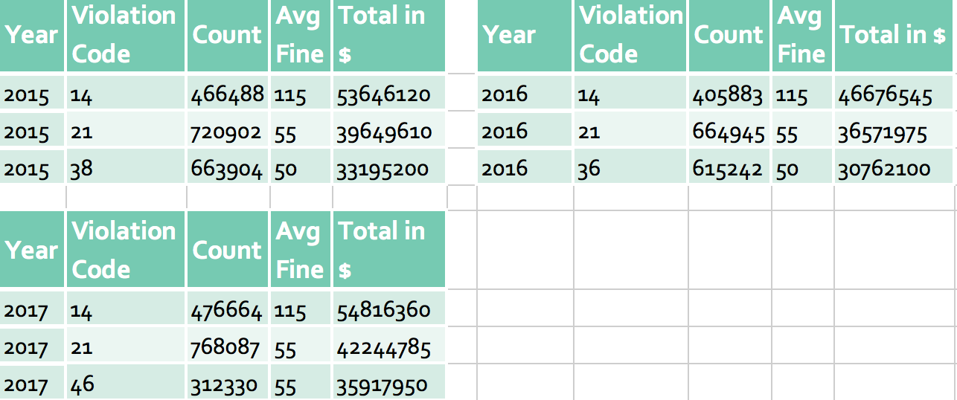
Top 3 Fines Collected
Violation codes 14 and 21 i.e No parking where not allowed collected the most amount in all years

Slide 31
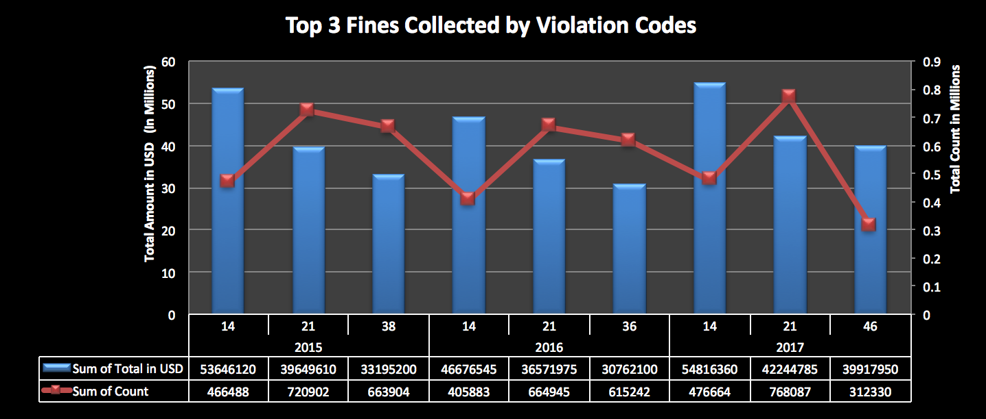
Top 3 Fines Collected by Violation Codes
Violation codes 14 and 21 i.e No parking where not allowed collected the most amount in all years

